Slide 1
Cumplimiento, laboratorios y resistencia al medicamento
Notes:
This session will cover 3 topics – it’s a longer session, so we will take a break.

Slide 2
Objetivos
Cumplimiento, laboratorios y resistencia al medicamento
Al final de esta unidad las participantes harán lo siguiente:
Definir qué significa cumplimiento.
Identificar razones comunes para los desafíos de cumplimiento.
Aportar preguntas para evaluar el cumplimiento.
Enumerar comportamientos o actividades que pueden indicar la falta de cumplimiento.
Identificar las barreras que los proveedores, las agencias y la comunidad en general han construido que dificultan el cumplimiento.
Reconocer los tipos de pruebas de laboratorio utilizadas para controlar la atención y el tratamiento contra el VIH de una persona.
Comprender por qué las pruebas de laboratorio son importantes para controlar la salud y cómo se pueden usar para administrar la atención.
Comprender el concepto de resistencia al medicamento.
Comprender qué tipos de pruebas de resistencia al medicamento están disponibles y cuándo se usan.
Notes:
Review the objectives.

Slide 3
VÍDEO
Notes:
First we’ll watch a video, called the ART Wall: Antiretroviral Therapy (ART). https://www.youtube.com/watch?v=1PEisyVjHsI&sns=em
It does a good job of explaining all three topics.

Slide 4
CUMPLIMIENTO
Notes:
Ask, “How do you define adherence?”

Slide 5
¿Qué es el cumplimiento?
Cumplimiento, laboratorios y resistencia al medicamento
Cuán de cerca sigue un régimen de tratamiento prescrito
Relación entre paciente y proveedor
Habilidad que se debe aprender
Los clientes deben poder hacer lo siguiente para cumplir con el tratamiento:
Comprender el régimen
Saber quién, qué, cuándo, dónde y por qué del tratamiento
Creer que pueden cumplirlo
Recordar que debe tomar los medicamentos
Integrar los medicamentos en el estilo de vida actual
Resolver problemas con los cambios en el horario y la rutina
Notes:
Review the slide.
Engage participants in discussion. Ask, “Has anyone missed or stopped taking a prescribed antibiotic? If so, what were some of the barriers that kept you from finishing the antibiotic? People with HIV are told by providers, family, and friends that they have to take HIV medications every day; however, there are sometimes barriers to doing so. What are they?”
Taking medication daily is often a skill that is learned, especially if you are a person who does not have a history of taking meds. If you don’t take HIV medications every day, HIV might multiply out of control. For the best viral load results, it is recommended that people with HIV should take over 90% of their pills correctly.
Doctors start patients on a preferred regimen from the HHS Guideline Recommendations; provide participants with a current copy (https://aidsinfo.nih.gov).

Slide 6
Factores que afectan el cumplimiento
Cumplimiento, laboratorios y resistencia al medicamento
Complejidad
Conocimiento
Factores del régimen
Factores clínicos
Enfermedad mental
Confianza
Conocimiento
Resistencia viral
Recordatorio de la enfermedad
Constancia
Factores del cliente
Temor
Notes:
There are many factors that affect adherence. Review the slide. Some barriers to adherence are pictured here.
Ask, “What behaviors may signal non-adherence?”

Slide 7
Preguntas para evaluar el cumplimiento
Cumplimiento, laboratorios y resistencia al medicamento
¿Cuál es la razón por la que está tomando este medicamento?
¿Cómo toma este medicamento?
¿Estás tomando este medicamento con la comida?
¿Dónde recibió información sobre este medicamento?
¿Qué utiliza para recordar que debe tomar el medicamento?
¿Qué hace cuando omite una dosis?
¿Qué problemas ha tenido mientras tomaba este medicamento?
Notes:
Ask, how do you gauge how adherent a client is?
Review the slide.
We often don’t ask clients about their readiness to start medications, which is extremely important. It’s important to know if the person you’re working with does not have a history of taking medication, avoids taking medication, has problems swallowing, or other tendencies that would prevent adherence. Once the doctor has prescribed medication and the person is not adherent, they may develop resistance quickly. It has been said that the first regimen is the best regimen, because doctors want patients to have longevity with their first line of prescribed medication.
Let’s take a look at the handout, 10 Questions to Ask Yourself Before You Begin HIV Treatment. Ask participants to take turns reading the questions on the handout.

Slide 8
Factores del cliente que afectan el cumplimiento
Cumplimiento, laboratorios y resistencia al medicamento
Conocimiento del régimen de tratamiento
“Se adapta” a su estilo de vida
Etapa de la enfermedad, nivel de bienestar
Sistema de apoyo
Creencia en la efectividad del tratamiento
Temor
Capacidad para controlar los efectos secundarios
Salud mental
Abuso de sustancias
Estigma
Creer que las drogas son ineficaces
Negación del estado de VIH
Notes:
Review the slide and discuss with participants.

Slide 9
Factores ambientales que afectan el cumplimiento
Cumplimiento, laboratorios y resistencia al medicamento
Transporte
Alojamiento
Comida
Tratamiento farmacológico
Servicio de salud mental
Red social
Cuidado de niños
Normas culturales
Notes:
Review the slide.
Ask, “What are some of the walls or barriers that providers, agencies, and the community at large have built that make it difficult for clients to adhere?”
Some barriers created by organizations can include:
Clinic hours - time flexibility
Clinic personnel that do not return calls
What about enrolling in insurance plans such as ADAP Ryan White plan or ACA?
Fear of a clinic employee breaching confidentiality or meeting someone you know.
Finances—paying for HIV medications
Transportation—in the case of meds, could a CHW or specialty pharmacy provide help by pick up or mailing?
Do providers know or refer clients to practical resources they need (e.g. support groups, hot meals, etc.)?
Can you think of any thing else that providers or agencies can do to help clients be successful in improving adherence?

Slide 10
El incumplimiento puede tomar muchas formas
Cumplimiento, laboratorios y resistencia al medicamento
No solicitar una receta
Tomar una dosis incorrecta
Tomar medicamentos en el momento equivocado
Omitir dosis
Interrumpir el tratamiento demasiado pronto
Tomar medicamentos de venta libre que interfieren con los medicamentos recetados
Notes:
Non-adherence can take many forms. These are more personal causes of non-adherence.
Review the slide.
Optional resource: Adherence Fact Sheet #405 at www.aidsunited.org.

Slide 11
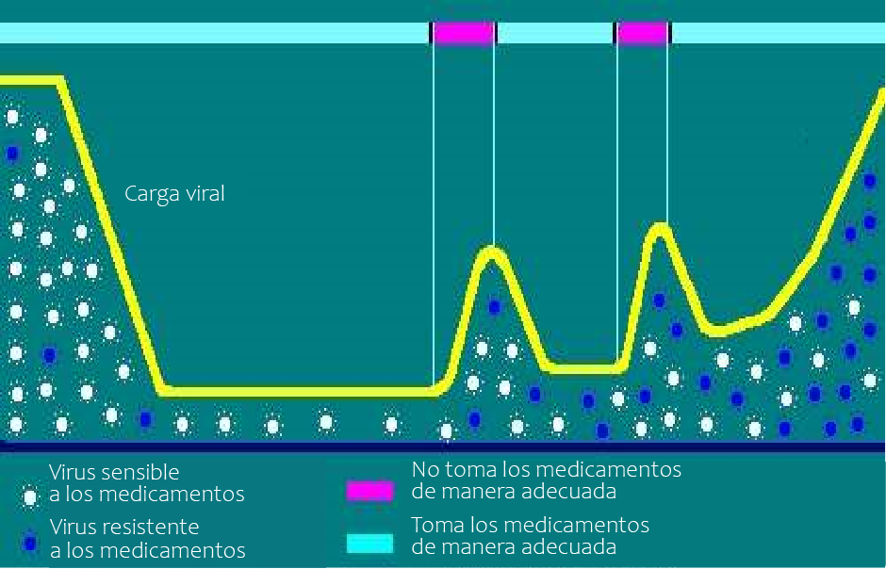
Cantidad de VIH e incumplimiento
Cumplimiento, laboratorios y resistencia al medicamento
Notes:
This chart shows a high viral load when a person is not taking medication.
Review the legend on the chart:
White – shows drug-susceptible virus
Blue – shows drug-resistant virus
Pink – shows that medication is not being taken properly
Light blue – shows that medications are being taken properly
As you look to the left, there are drug susceptible viruses that can be controlled by taking medication; there are fewer blue resistant virus strains. However, to the right there are a lot of blue drug-resistant viruses in the absence of not taking medication.

Slide 12
Cumplimiento, laboratorios y resistencia al medicamento
Evaluación del cumplimiento: 10 preguntas que debe hacer
Notes:
Ask, “What questions would you ask a client if you wanted to assess how adherent they are to their medication regimen?” Refer to handout, Assessing Adherence: Ten Questions You Should Ask.

Slide 13
Revisión de las herramientas de cumplimiento
Cumplimiento, laboratorios y resistencia al medicamento
Notes:
Pass around adherence tools (medication watch, calendars, pill bottles, and trays etc.) for in person training. Also review the following:
Adherence and medication go hand in hand. In the past, a huge part of non-adherence was the pill burden for clients (i.e. some taking up to 16 pills a day)—but not anymore. STR or (single-table regimens) have made taking anti-retrovirals easier; today there are so many choices, some of which cause little to no side effects.
Another advance researchers have made is a change in the formulation of one of the most prescribed medications, Truvada. The tenofovir DF (TDF) formulation of Truvada has been decreased from 300mg, which was associated with long-term decreases in bone mineral density and kidney problems in some patients. The new formulation, tenofovir alafenamide, is 25mg and in some medications 10mg; doctors are seeing fewer kidney and bone issues with the TAF formulation compared to TDF in clinical trials.
Explain the concept of U=U which stands for Undetectable=Untransmittable.
Undetectable: By taking the right HIV medicine every day, one can lower the amount of HIV in the blood to become “undetectable.” This doesn’t mean the client no longer has HIV – it means that by continuing their plan of treatment, they can still have a healthy life with HIV.
Untransmittable: People who are undetectable for at least 6 months cannot transmit the virus to others as long as they stay undetectable by taking their HIV medicine every day and seeing their doctor regularly.
Additional resources for further reading and information about U=U: https://www.preventionaccess.org/, http://www.thebody.com, https://docs.wixstatic.com/ugd/de0404_9953eed1181949618d205be7e368635f.pdf,
CDC, and many other websites.

Slide 14
RESISTENCIA
Notes:
Take a 10 minute break.
After the break, ask:
“What is drug resistance?”
“What do you think causes drug resistance?”
Allow participants to respond, then review answers on the next slide.

Slide 15
Comprender la resistencia al medicamento
Cumplimiento, laboratorios y resistencia al medicamento
¿Qué es la resistencia al medicamento?
El virus puede adaptarse, crecer y multiplicarse en presencia de medicamentos.
Un medicamento o una clase de medicamento ya no son efectivos contra el virus.
¿Qué causa la resistencia al medicamento?
La replicación rápida del VIH a veces produce errores (mutaciones).
Estos virus mutantes se vuelven resistentes al tratamiento.
Si un medicamento no funciona contra un virus mutado, ese virus se reproducirá rápidamente.
La carga viral aumenta.
Es posible que deba cambiar los medicamentos para controlar el VIH.
Los medicamentos contra el VIH se usan en combinación para bloquear la reproducción en el ciclo de vida del VIH.
La combinación de medicamentos dirigidos a varios objetivos diferentes es mucho mejor para prevenir la reproducción del VIH que uno solo.
¿Qué tan común es la resistencia al medicamento?
La resistencia es común y es un desafío importante en el tratamiento contra el VIH:
Disminuye la capacidad de los medicamentos contra el VIH para controlar el virus.
Las personas con VIH que toman o han tomado medicamentos contra el VIH tienen más probabilidades de tener virus resistentes y menos opciones de medicamentos.
Tres de cada cuatro personas fallaron en el tratamiento debido a la resistencia al medicamento.
Una de cada cuatro personas recién infectadas ya es resistente al menos a una clase de medicamentos.
Las pruebas de cantidad de VIH ayudan a determinar la resistencia al medicamento.
Notes:
Review the slide.
What is drug resistance?
HIV is “resistant” to a drug if it keeps multiplying rapidly while a person is taking the drug.
Physical changes or (mutations) in parts of the virus that prevent the medications from working cause resistance.
HIV mutates almost every time a new copy is made. Not every mutation causes resistance. The “wild type” virus is the most common form of HIV. Anything different from the wild type is considered a mutation. An antiretroviral drug (ARV) won’t control a virus that is resistant to it. It can “escape” from the drug.
What causes resistance?
HIV usually becomes resistant when it is not totally controlled by drugs someone is taking. In short it is caused by:
Transmitted resistance: about 10% of people who contract HIV are already resistant to one or more ARVs. The person inherited resistance from the person they contracted the virus from
Missed doses or non-adherence
Re-infection – condomless sex with a person with HIV.
If a drug does not work against a mutated virus, that virus will reproduce rapidly and viral load increases. A person may then have to change drugs to get HIV under control. HIV drugs are used in combination to block reproduction in the HIV life cycle; however, drug resistance is very common.

Slide 16
VÍDEO
Notes:
Play a short video on resistance. https://www.youtube.com/watch?v=_H1zLcJZxeE

Slide 17
Prueba de resistencia al medicamento
Cumplimiento, laboratorios y resistencia al medicamento
¿Por qué son importantes las pruebas de resistencia al medicamento?
Brindan una imagen completa de las opciones de tratamiento.
Ayudan a evitar efectos secundarios innecesarios de los medicamentos y el costo de los medicamentos asociados con el consumo de medicamentos que probablemente no funcionen.
Ayudan a desarrollar un plan de tratamiento efectivo.
¿Cómo se prueba la resistencia al medicamento?
Prueba fenotípica: evalúa la capacidad del virus para replicarse en presencia de ARV/medicamentos.
Prueba genotípica: identifica mutaciones genéticas en el VIH de un individuo, que se sabe que están asociadas con el VIH resistente al medicamento. Los resultados indican sensibilidad o resistencia al medicamento; prueba más común.
Notes:
Review the slide.
Provide the handout of a GenoSure sample copy of a resistance test for a patient.
Explain that some resistance tests are called GenoSure or PhonoSense tests.
Both tests show if a person has become resistant to HIV medication. In this case, a physician will need to change the patient's medication regimen.
Tests usually show the word “resistant” or “sensitive” next to the name of the medication. Sensitive = patient not resistant to the drug; Resistant = patient is resistant to the drug; “resistant possible” means that if the patient continues on the path of not taking the drug properly they will soon develop resistance.
Genotypic tests are normally performed at the first lab visit to determine if the person that contracted HIV already has resistance from the person that transmitted the virus to them. Physicians may or may not tell the patient they are performing the test.
Phenotypic test is offered after patients have been non-adherent and gone through most HIV medications with multiple resistances to many medications. For the test, HIV medications are in a petri dish and the person's blood sample is put into each medication slot and allowed to cure overnight. The test is costly but does show the physician which medications a patient can still take that may provide benefit and slow the progress of the disease.

Slide 18
Prueba de resistencia al medicamento
Cumplimiento, laboratorios y resistencia al medicamento
¿Cuándo deben usarse las pruebas de resistencia al medicamento?
Antes de que comience el tratamiento
Después de que fracase el tratamiento
¿Cómo prevenir la resistencia al medicamento?
Tomar los medicamentos contra el VIH a tiempo, siempre
No compartir agujas ni tener relaciones sexuales sin condón con alguien que tenga VIH
Notes:
Review the slide.
When should drug resistance testing be used?
Genotype tests are generally performed before therapy begins. Phenotypic tests are performed when treatment has failed due to non-adherence.
Being adherent is the best way to prevent drug resistance.

Slide 19
LABORATORIOS
Notes:
Ask, “What are the benefits of keeping lab appointments?”
Allow for participants to answer, then review the slides.

Slide 20
Comprender los valores de laboratorio
Cumplimiento, laboratorios y resistencia al medicamento
Comprender los valores de laboratorio y por qué son importantes
Notes:
Explain that lab tests are some of the most important ways that clients and their healthcare provider can monitor their health. There are a variety of monitoring tests to help gauge HIV disease progression and the state of overall health for people with HIV.

Slide 21
Los médicos usan pruebas de laboratorio para controlar la salud
Cumplimiento, laboratorios y resistencia al medicamento
Pruebas de laboratorio:
Detectar la presencia de organismos causantes de enfermedades
(p. ej. bacterias, virus, parásitos) que pueden estar relacionados con el VIH
Indicar cuándo tratar, cómo tratar y si el tratamiento está funcionando
Identificar el desarrollo de efectos secundarios relacionados con el tratamiento
Detectar otras infecciones y problemas asociados con la infección por VIH
Notes:
Review the slide.

Slide 22
Conceptos básicos de laboratorio
Cumplimiento, laboratorios y resistencia al medicamento
Confirme su información personal:
Nombre
Edad
Sexo
Número de historia clínica
Pregunte lo que no entienda.
Notes:
Review the slide.
It’s important to have clients confirm that all personal information is theirs. It’s also important to encourage clients to be proactive and ask for a copy of their labs each and every time they meet with their doctor to review their labs.

Slide 23
¿Qué hacen los medicamentos contra el VIH?
Cumplimiento, laboratorios y resistencia al medicamento
Ayudan a controlar el VIH al reducir el crecimiento de virus nuevos.
Ayudan a mantener baja la cantidad de VIH.
Carga viral = la cantidad de VIH en la sangre
Los medicamentos para el VIH no curan el VIH o el SIDA.
Reducen la carga viral.
Notes:
23
HIV medication helps control HIV by reducing the growth of new virus. HIV medications can be very effective at lowering viral load, which is the amount of HIV in the blood. HIV medications do not cure HIV infection or AIDS.

Slide 24
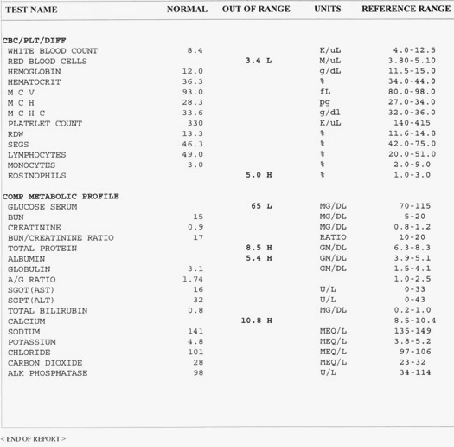
Cómo controlar la salud
Cumplimiento, laboratorios y resistencia al medicamento
Pruebas de laboratorio
Cantidad de VIH
Recuento de células CD4
Recuento sanguíneo completo (CBC)
Lípidos
Glucosa (azúcar en la sangre)
Función hepática
Función renal
Resistencia a los medicamentos contra el VIH
Notes:
24
A client’s healthcare provider will order a number of lab tests to help monitor treatment and disease progression. These may include HIV viral load, CD4 cell count, complete blood count (CBC), lipids, glucose, liver and kidney function, and HIV drug resistance.

Slide 25
¿Por qué son importantes las pruebas de laboratorio?
Cumplimiento, laboratorios y resistencia al medicamento
Las pruebas de laboratorio pueden ayudar a los clientes y a su proveedor de atención médica a hacer lo siguiente:
Decidir cuándo comenzar el tratamiento contra el VIH.
Decidir qué medicamentos contra el VIH son mejores para ellos.
Saber si los medicamentos están funcionando o no.
Saber si alguno de los medicamentos está causando efectos secundarios.
Estar atento a otras infecciones y problemas.
Comprender las pruebas de laboratorio lo ayuda a hacerse cargo de su salud.
Notes:
25
Review the slide.

Slide 26
¿Cuándo deben hacerse las pruebas de laboratorio?
Cumplimiento, laboratorios y resistencia al medicamento
Cuando a una persona se le diagnostica el VIH por primera vez, por lo general cada 3 a 6 meses o cada vez que el médico lo considere necesario
Cuando una persona comienza a tomar medicamentos y antes de cambiar a diferentes medicamentos.
Incluso cuando se siente bien, las pruebas de laboratorio pueden decirle cosas sobre su cuerpo que es posible que no pueda ver o sentir.
Notes:
26
A healthcare provider will order a number of lab tests when a patient is first diagnosed with HIV to determine baseline values; every time they start or switch to new medicines; and to help monitor ongoing treatment.
Most of these tests should be performed regularly, usually every three to six months or whenever the healthcare provider feels it’s appropriate.

Slide 27
ACTIVIDAD: LABORATORIOS
Notes:
Ask participants to pair up for a lab practice activity.

Slide 28
Revisión de prueba de laboratorio de muestra del cliente
Cumplimiento, laboratorios y resistencia al medicamento
Notes:
Using the Lab Worksheet handout, we will discuss specific monitoring lab tests for people with HIV and explain the significance of why each test is being monitored.

Slide 29
Hoja de actividades: laboratorio
Cumplimiento, laboratorios y resistencia al medicamento
FECHAS
CD4 | salud del sistema inmunitario
CD4% | % de CD4 en funcionamiento
VL | virus enemigo
AST | enfermedad hepática muscular
ALT | enfermedad de detección hepática
BUN | disfunción renal y hepática o en la filtración de desechos
CREATININA | daño renal y hepático o en la filtración de desechos
Triglicéridos | grasa en sangre
colesterol total | menos de 200
LDL | menos de 130
HDL | mayor que 40
Glucosa | azúcar en sangre <99
Notes:
Let’s take a look at this Lab Worksheet. You also have it as a handout.

Slide 30
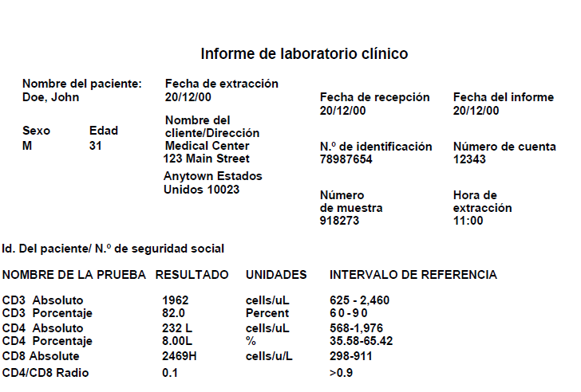
Muestra: prueba de CD4
Cumplimiento, laboratorios y resistencia al medicamento
Notes:
Reviewing our labs on the CD4 Test, you see 4 columns:
Test Name– identifies the type of procedure performed
Result – the patient’s actual result or percent
Units – how are the results measured in cells or percent
Reference Range – the normal or reference ranges for a person without HIV as compared to the actual result of a person with HIV. The result column will be identified as H for High or L for Low when compared to the patient’s actual result.
Using the Lab Worksheet and the following sample tests:
CD4
Blood Chemistry
Viral load Sample Tests
Identify and write in the lab results for each test on the Lab Worksheet (CD4, VL, Liver, Kidney, Cholesterol, and Glucose). Compare them to the actual result of a person living with HIV. The result column will be identified as H for High or L for Low when compared to the patient’s actual result.
Guide participants as follows:
Ask, “What is Mr. Doe’s CD4 absolute or count?”
Answer: 232. Please write 232 on your Lab Activity Sheet beside CD4 Count.
Is this number considered high or low compared to the reference range?
What is Mr. Doe’s CD4 Percent?
Answer: 8%. Please write 8% on your Lab Worksheet beside CD4 Percent.
Is it low or high compared to the reference range?
The CD4 Percent is the better indicator for HIV progression for Mr. Doe. The CD4 Percent is not variable; percentages are usually more stable over time than absolute counts.
CD4 absolute or cell counts often fluctuate due to factors including time of day (levels are usually higher in the morning), fatigue, stress, vaccinations, infections such as flu, and monthly menstrual cycles in women.

Slide 31
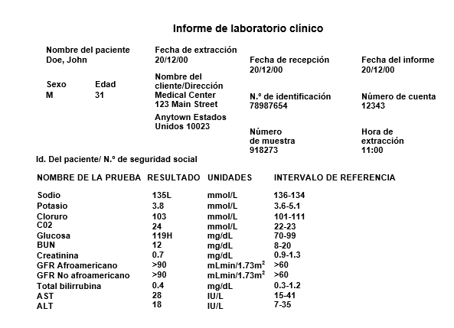
Muestra: pruebas de química sanguínea
Cumplimiento, laboratorios y resistencia al medicamento
Notes:
Now let’s review the blood chemistry tests. The blood chemistry, or chem panel, measures many important substances in the blood. Although the chem panel does not directly measure HIV disease progression, it can help indicate how well various organs are functioning and provide valuable information about drug side effects.
Find the Glucose, BUN, Creatinine, AST and ALT.
Please write the results of all the procedures beside the name on the Lab Worksheet.
Let’s discuss one at a time:
Glucose – sugar is carried in the blood in the form of glucose; it’s broken down by cells to provide energy. What is a normal glucose range?
BUN – (Blood Urea Nitrogen) is a metabolic waste product that is normally filtered out by the kidneys and excreted in the urine. Elevations may indicate kidney dysfunction or a body fluid imbalance (e.g. dehydration).
Creatinine – waste product of protein metabolism is also normally excreted by the kidneys. Elevation may indicate kidney damage.
AST-liver muscle disease
ALT – early detection of liver damage

Slide 32
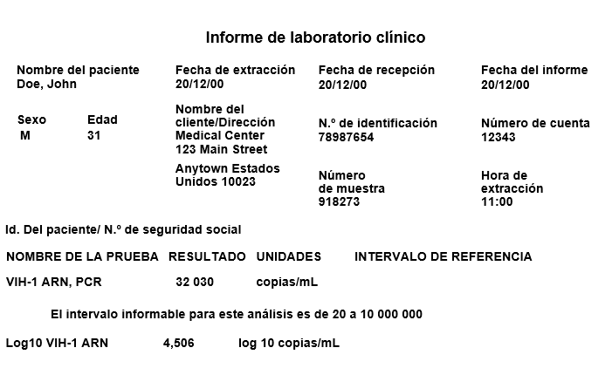
Muestra: prueba de cantidad de VIH
Cumplimiento, laboratorios y resistencia al medicamento
Notes:
Viral load test:
Finally, the viral load test is the most significant. Viral load tests measure the amount of HIV RNA or virus in the blood. The presence of RNA indicates that the virus is actively replicating (multiplying).
Viral load is expressed as copies of RNA per milliliter of blood (copies/mL) or in terms of logs.
If the level of HIV is too low to be measured, viral load is said to be undetectable, or below the limit of quantification.
However, undetectable viral load does not mean that HIV has been eradicated; people with undetectable viral load maintain a very low level of virus. Even when HIV is not detectable in the blood, it may be detectable in the semen, reproductive organs, tissues, lymph nodes, and brain.
Guide participants as follows:
Ask, “What is this person’s viral load?”
Answer: 32,030. Please write the results of the HIV-1 RNA, PCR or viral load on the Lab Worksheet.
Ask, ”What is the recommended viral load for patients?
Answer: Less than 20 or 40 depending on the lab.
Ask, “What is meant by the term viral suppression?”
Answer: People who are virally suppressed report a viral load of 200 copies or HIV-1 RNA, PCR or virus in the blood.
Tell participants that they should work with the client to also identify other tests that may be concerning for the client (e.g. hemoglobin or A1c, cholesterol etc.)
U=U a new term is Undetectable= HIV Untransmittable
In September 2017, the CDC (Centers for Disease Control and Prevention) officially supported the medically proven claim that people who are HIV+ and Undetectable and remain consistently undetectable or Virally Suppressed (20-200 copies) cannot transmit HIV to partners who do not have HIV. Nearly 20,000 cases were studied and all HIV negative persons remained HIV negative. (McCray & Mermin, 2017)

Slide 33
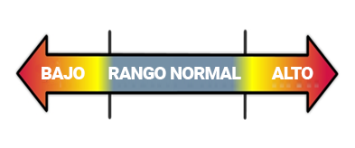
¿Qué es un valor de laboratorio “normal”?
Cumplimiento, laboratorios y resistencia al medicamento
Los valores “normales” o de “rango de referencia” se encuentran en un informe de laboratorio
Los resultados de laboratorio pueden ser bajos, altos o dentro del rango normal
Si los valores de laboratorio son demasiado altos o demasiado bajos, el cliente debe hablar con su médico
Notes:
33
Please note: The remainder of the lab slides are optional and do not need to be covered unless further clarification is needed. The lab activity alone reviews material on the remaining PowerPoint slides.
“Normal” values or reference ranges can vary from lab to lab, depending on the equipment and/or testing method used. It is important to compare your results to the range shown on the lab report. The lab results can be low, high, or within normal range.
Test results can be affected by many factors, such as age or gender, the time of day when the sample was taken, active infections, the stage of HIV and food. For example, some test samples need to be taken after a person has fasted for several hours.
If any labs values are too high or too low, encourage your client to discuss the results with their healthcare provider.

Slide 34
Cantidad de VIH
Cumplimiento, laboratorios y resistencia al medicamento
Mide la cantidad de VIH en la sangre.
Es muy útil para decidir cuándo comenzar o cambiar los medicamentos contra el VIH.
La meta: mantener la cantidad de VIH lo más baja posible <20 copias por mL de sangre
Notes:
34
HIV viral load is a test that measures the amount of HIV virus in the blood. When used in combination with CD4 cell count results, viral load is extremely useful in determining when to begin and change your HIV therapy.
The goal of HIV therapy is simple: to keep the amount of HIV in the blood as low as possible.

Slide 35
Explicación de los resultados de la prueba de cantidad de VIH
Cumplimiento, laboratorios y resistencia al medicamento
Una persona con VIH puede tener una carga viral de menos de 20 copias a más de 1 000 000 de copias por mililitro de sangre (copias/mL)
Menos de 20 copias/mL = “indetectable”
Indetectable no significa que la persona está curada.
Menos de 200 copias/mL = “viralmente suprimido”
La supresión viral significa que el virus de la persona ha sido controlado. Todavía está presente, pero a niveles bajos, suprimiendo o reduciendo la función y la replicación de un virus.
Notes:
35
A person’s viral load can measure from less than 20 copies of HIV per milliliter of blood to more than one million copies. Although there is no cure for HIV, when your viral load is below 20 copies/mL, this is known as “undetectable” because the test is not sensitive enough to give a reliable number. Again, as we discussed previously - Undetectable does not mean that the person is cured. You may also see less than 400 copies/mL referred to as undetectable when less sensitive tests are used.
An important goal of HIV therapy is to encourage the client to get their viral load to undetectable.

Slide 36
Recuento de células CD4
Cumplimiento, laboratorios y resistencia al medicamento
Mide la cantidad de células CD4 (también llamadas células T ayudantes) en el cuerpo
Indica la salud del sistema inmunitario
Cuantas más células CD4, más fuerte es el sistema inmunitario
Menos células CD4
pueden provocar un
aumento de las infecciones
Notes:
36
CD4 cells are an important part of the immune system. Therefore, the CD4 cell count is a key measure of the health of the immune system. The more CD4 cells, the stronger the immune system is and the better able clients are to fight off infections.
Certain factors can cause the CD4 cell count to vary. These include time of day, fatigue, and stress. It's best to have blood drawn at the same time of day for each CD4 cell test and to use the same laboratory. When the body fights an illness, CD4 counts go up. Vaccinations can cause the same effect. Don't check CD4 cell count until two weeks after recovering from illness, or immediately after a vaccination.

Slide 37
Explicación de los resultados del recuento de células CD4
Cumplimiento, laboratorios y resistencia al medicamento
Los resultados se pueden informar como dos valores:
El recuento de células CD4 (las fluctuaciones pueden verse afectadas por el estrés)
El porcentaje de células CD4 (sin variación)
500-1600 mm³
500-1500
células/mm³
20 %-40 %
Notes:
37
CD4 cell tests are normally reported as the number of cells in a cubic millimeter of blood. Normal counts are between 500 and 1,500. Because CD4 cell counts can vary, some healthcare providers prefer to look at what’s called the CD4 cell percentage. The CD4 cell percentage refers to the proportion of all lymphocytes that are CD4 cells. For example, if your CD4 percentage is 34%, it means that 34% of your lymphocytes were CD4 cells. The normal range is between 20% and 40%.
Anyone who has fewer than 200 CD4 cells or a CD4 percentage of less than 14% is considered to have AIDS.
In closing, understanding labs enables clients to:
Play an active role in their health care
Use new knowledge of lab tests and lab values to be a partner with their doctor
Live a healthier life

Slide 38
ACTIVIDAD DE ESCENARIO POSIBLE: CUMPLIMIENTO Y RESISTENCIA
Notes:
(Approximately 20 minutes; 10 for group discussion and 10 for presenting feedback to the larger group).
Divide participants into three groups. There are three scenarios: A, B, and C. Give each group an adherence scenario to read, have them brainstorm as a group and answer the following questions in the assigned group. Write the four questions below on a flip chart. Each group will select a spokesperson who will report the groups’ answers to the class.
What questions can the CHW ask the client?
Are there barriers or factors that would affect the client’s adherence?
What strategies could the CHW suggest?
Are there any concerns regarding adherence or resistance?
To close the session, review the following points:
90% adherence is the goal and is key to living a long healthy life with HIV.
Resistance can happen at any time when the virus is not totally controlled by HIV medications; it’s important to keep medical appointments.
Trends are important; however labs should be viewed over time, not just once to determine medical outcomes.
Always make sure the lab report you are reading belongs to the correct client.
Every lab is different, so what may be out of range for one lab may not be for another.
Encourage clients to use portals or sources like MyChart, if available, so they can review their own labs and request copies prior to or at doctor visits so they can ask questions.

